Slide 1
University - Industry Collaboration: Common Myths The innovation policy experience from the South Moravian Region Jan Slovák Masaryk University, Brno

Slide 2
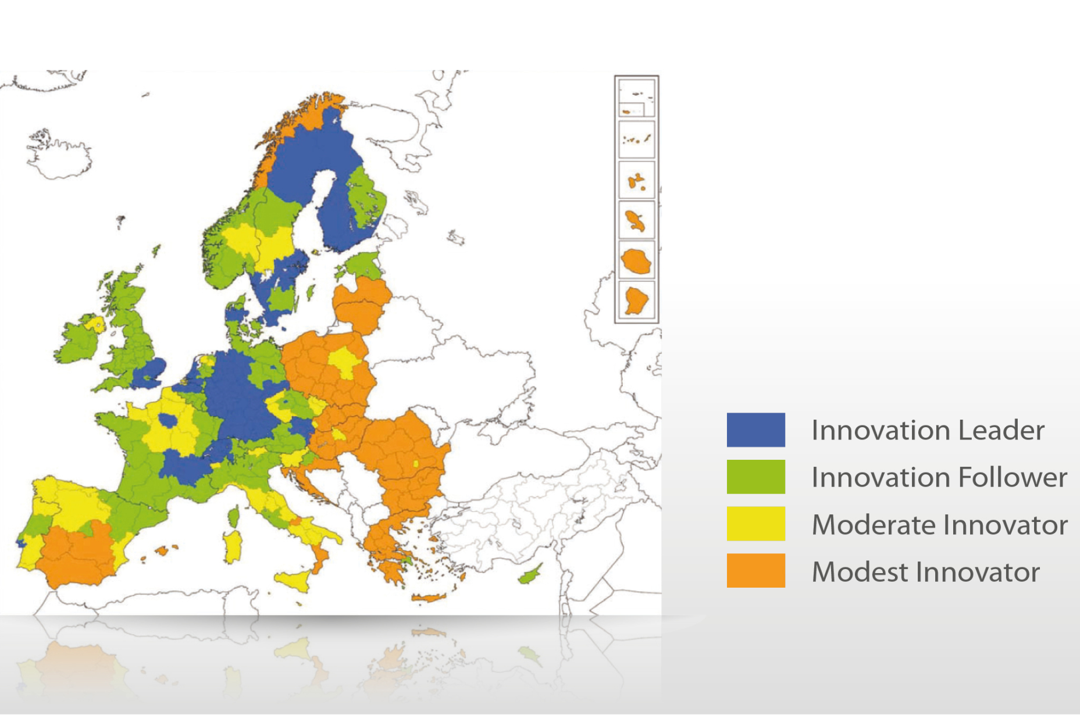
Our vision: to become a region with a strong Innovation Technology Profile via University – Industry collaboration

Slide 3
Main vision: to become a region with a strong Innovation Technology Profile

Slide 4
Frequent myths:
Universities should focus on applications and they will get financed through the collaboration with commercial partners. [governance]
Universities do not need „products“, industry will buy „ideas“. [universities]
Universities should deliver products and services as any other company. [commercial partners]
Universities can produce „tailor made“ graduates. [everybody]

Slide 5
South Moravian Regional Innovation Strategy I-IV

Slide 6
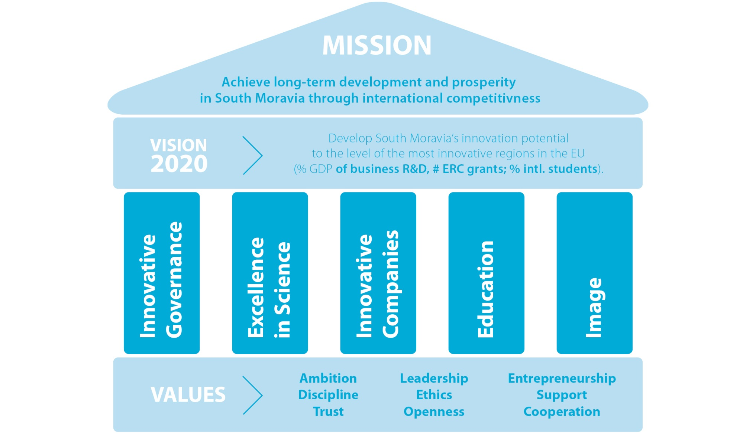
Strategy for RIS4 (2014 – 2020)

Slide 7
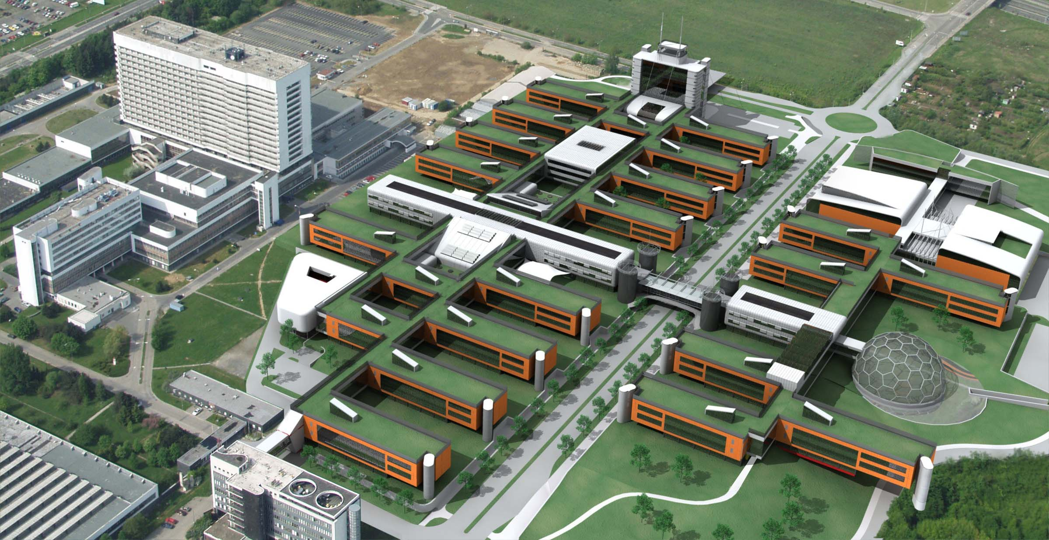
Selected Achievements 2001 – 2016
growing VC investments, 150+ supported startups, 700+ hi-tech jobs there, 20 000+ jobs through foreign investors
Masaryk University new campus (€ 200+ mill.)

Slide 8
Selected Achievements 2001 – 2016
growing VC investments, 150+ supported startups, 700+ hi-tech jobs there, 20 000+ jobs through foreign investors
Masaryk University new campus (€ 200+ mill.)
+ € 700 mill. investment in public R&D
54 top positions for foreign researchers via SoMoPro
quick growth of private R&D

Slide 9
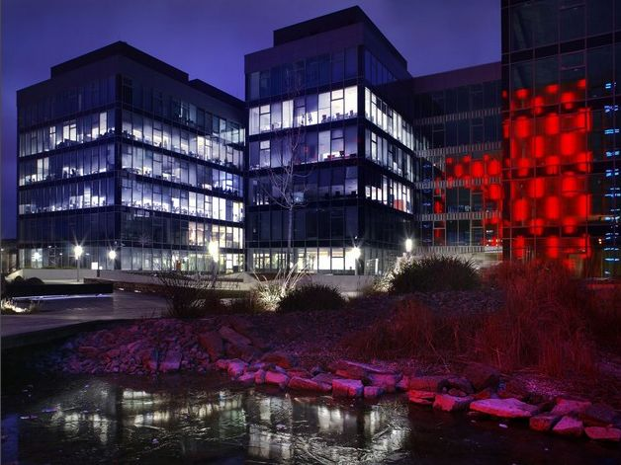
Selected Achievements 2001 – 2016
growing VC investments, 150+ supported startups, 700+ hi-tech jobs there, 20 000+ jobs through foreign investors
Masaryk University new campus (€ 200+ mill.)
+ € 700 mill. investment in public R&D
54 top positions for foreign researchers via SoMoPro
quick growth of private R&D

Slide 10
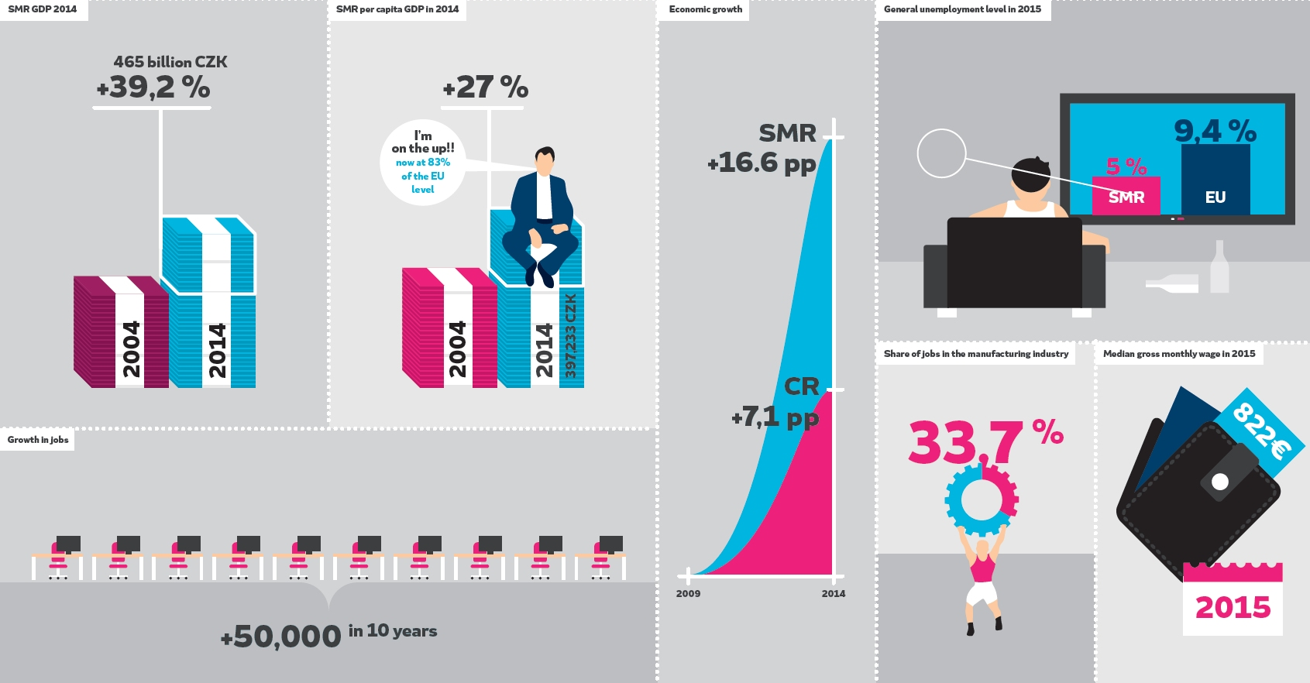
Growth of the South Moravian economy …

Slide 11
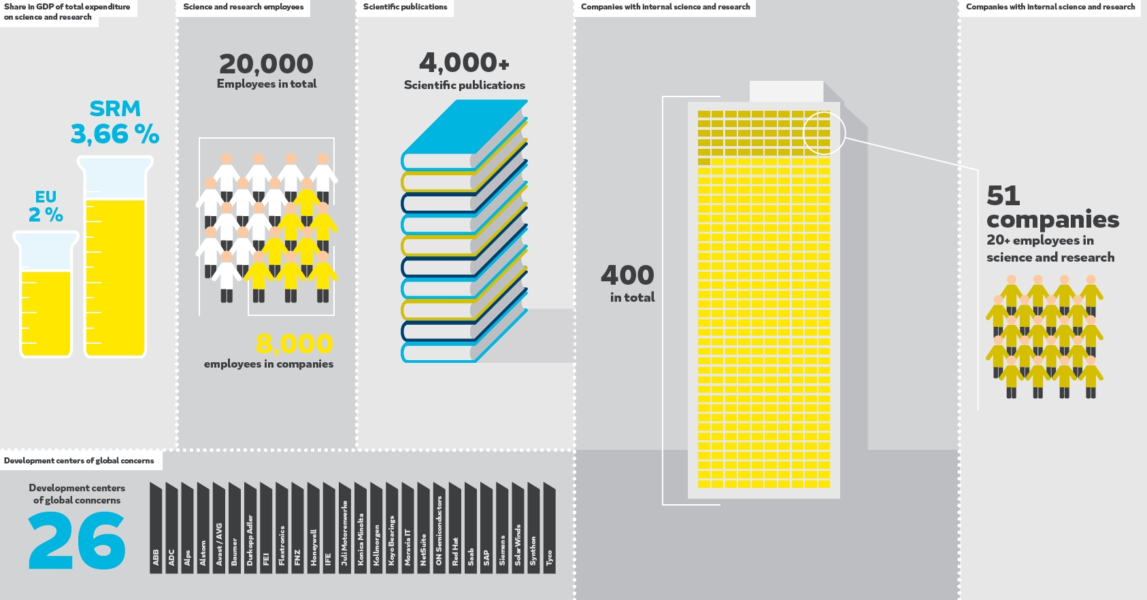
South Moravian knowledge economy …

Slide 12
Lessons learned so far …
keep strategic focus (specialisation), but do not forget variations
robust governance structures must ensure flexibility of the strategy
include and develop international contacts
be close to the policy research (S3 Platform, etc.)
manage strategy as a portfolio project management
have the best people on boards
documents and processes are not enough, we need to develop people’s minds

Slide 13
Simply: we are extending the „Vienna blue spot“ a bit towards north …
Thanks
for the
Attention!

